Slide 1
section 2.9 Factoring Difference of Squares
© Copyright all rights reserved to Homework depot: www.BCMath.ca

Slide 2
Difference of Squares:
You are now entering a level of algebra that is more advanced than a typical math 8 course
Factoring a difference of squares can be used for solving many challenging problems
Difference → Subtraction
Difference of Squares → Subtraction of two perfect squares
When factoring a difference of squares, you will get two binomials that are “CONJUGATES” of each other. One will have a “plus” sign in the middle, the other will have a “minus” sign in the middle

Slide 3
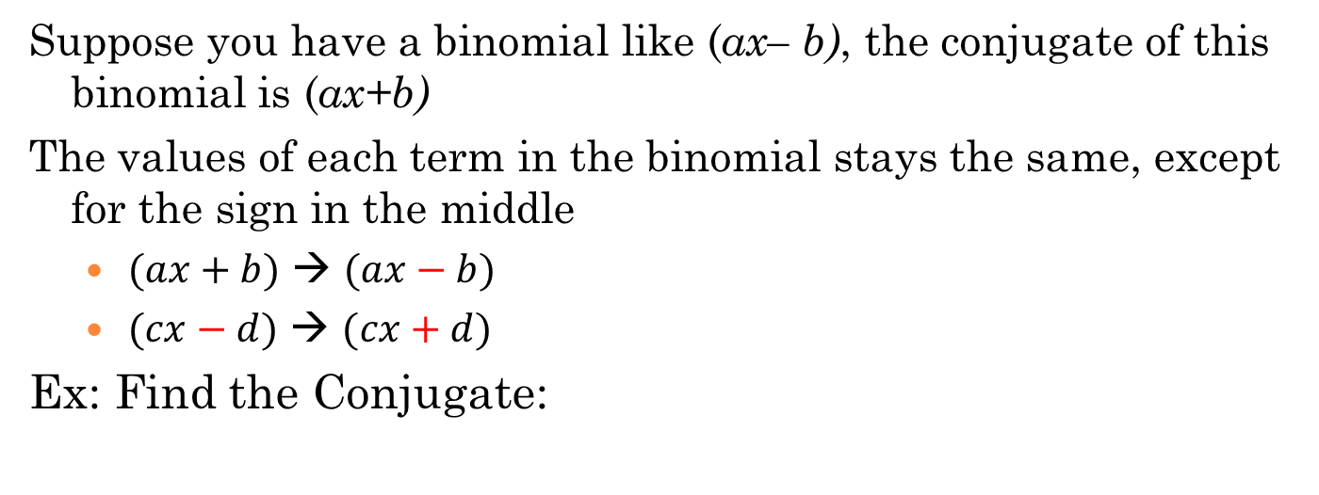
II) What are Conjugates?
Suppose you have a binomial like (ax– b), the conjugate of this binomial is (ax+b)
The values of each term in the binomial stays the same, except for the sign in the middle
  $(ax+b)$ → $(ax−b)$
  $(cx−d)$ → $(cx+d)$
Ex: Find the Conjugate:

Slide 4
Q: What happens when you multiply a binomial with its conjugate?
Ex: Expand the following
1. The middle two terms will always cancel each other out
2. The first and last terms are always perfect squares
3. The middle sign is always a subtraction

Slide 5
Ex: Indicate what the missing terms are:

Slide 6
III) Why Difference of Squares???
Suppose you have two large squares and you want to find the area in between. Big square Area is “a²” and small square area is “b²”
This blue area represents the difference of the two squares. Cut and shift this blue area into a trapezoid:
Width
Length

Slide 7
Practice: Factor the following by using the Difference of Squares formula. Note: Factor Completely!!

Slide 8
Practice: Factor completely

Slide 9
Ex: Factor completely

Slide 10
Challenge: Factor
Can’t Factor!! Not a Difference

Slide 11
Evaluate:
Solve for all real values of “x”
Given that “x” and “y” are positive integers, what are all the possible pairs of (x,y)?

